Slide 1

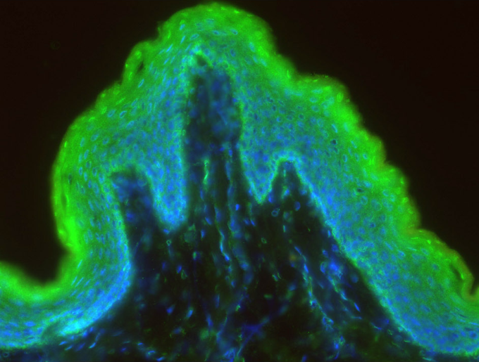
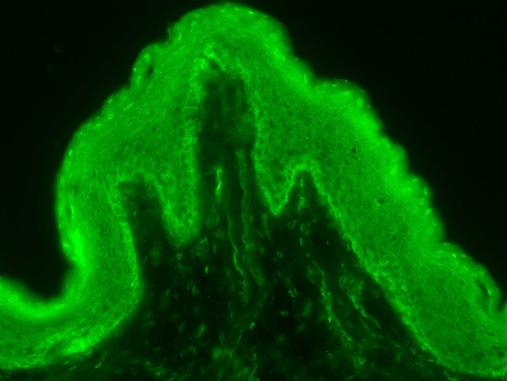
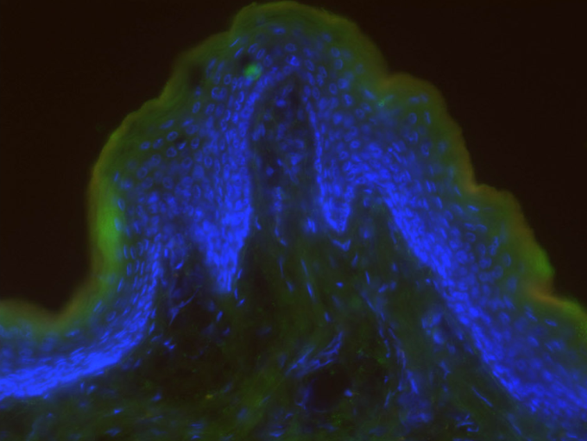
ReliaTech GmbH
Rabbit anti-human MesP1
(Cat #102-PA52)
Immunofluorescence staining of cryo-sections of unfixed human foreskin with anti-human MesP1 (dilution 1:100) [Cat# 102-PA52] and counter staining of nuclei with Dapi.
Note: The specific green MesP1 signal is visible in the epidermis and in dermal blood vessels (left and middle picture). Right picture: Negative control without primary antibody.
The experiment was performed by the research group of Prof. Dr. J. Wilting and Dr. K. Buttler, University Medicine Göttingen, Germany.
http://www.reliatech.de / orders@reliatech.de

